Slide 1
Voltage-dependent membrane permeability
By: Nicole Phillips

Slide 2
Learning Objectives
Explain the function and utility of the voltage clamp method
Explain the voltage- and time-dependent properties of conductance changes during an action potential
Describe how the action potential travels along the axon and how myelin influences propagation.
Identify symptoms of Multiple Sclerosis and make connections with demyelination and axonal damage.

Slide 3
Part 1:
Voltage clamp studies

Slide 4
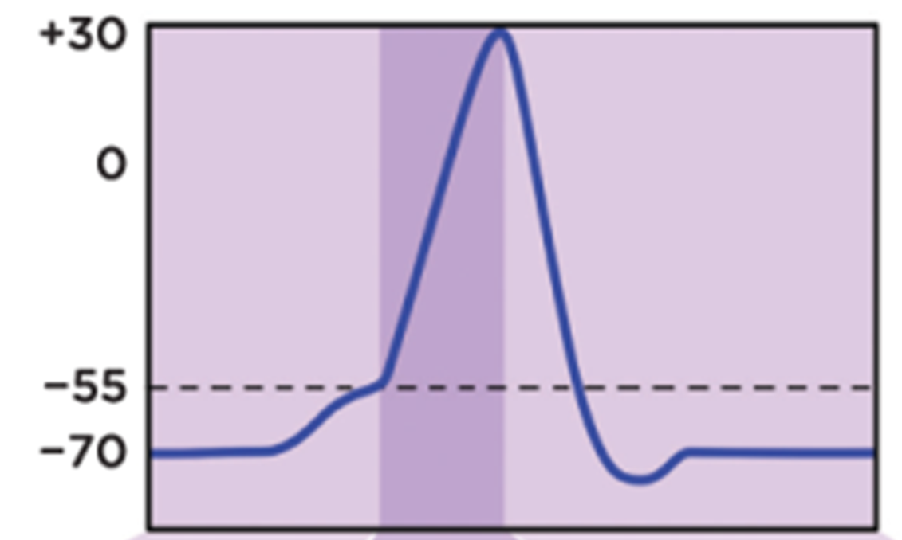
The action potential
Definition: a rapid, brief reversal in membrane potential
  intracellular compartment becomes (+) relative to extracellular
Results from several voltage- and time-dependent changes in membrane permeability
  Changes in ion conductance

Slide 5
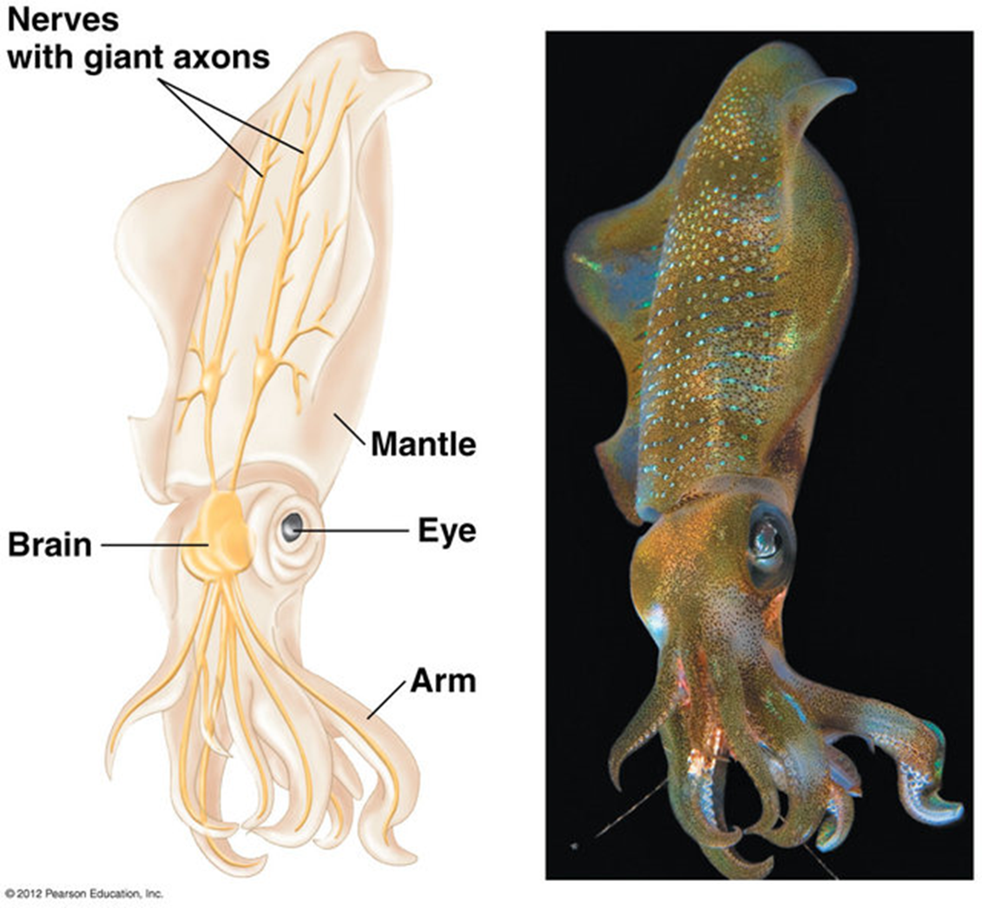
The Squid giant axon
Can be seen with the naked eye
  Up to 1mm in diameter
Likely evolved to promote survival

Slide 6
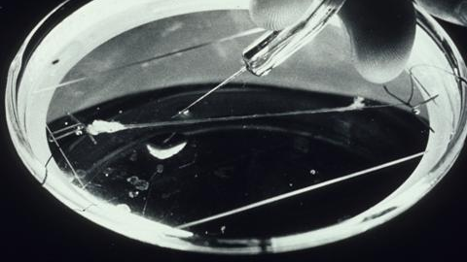

Slide 7
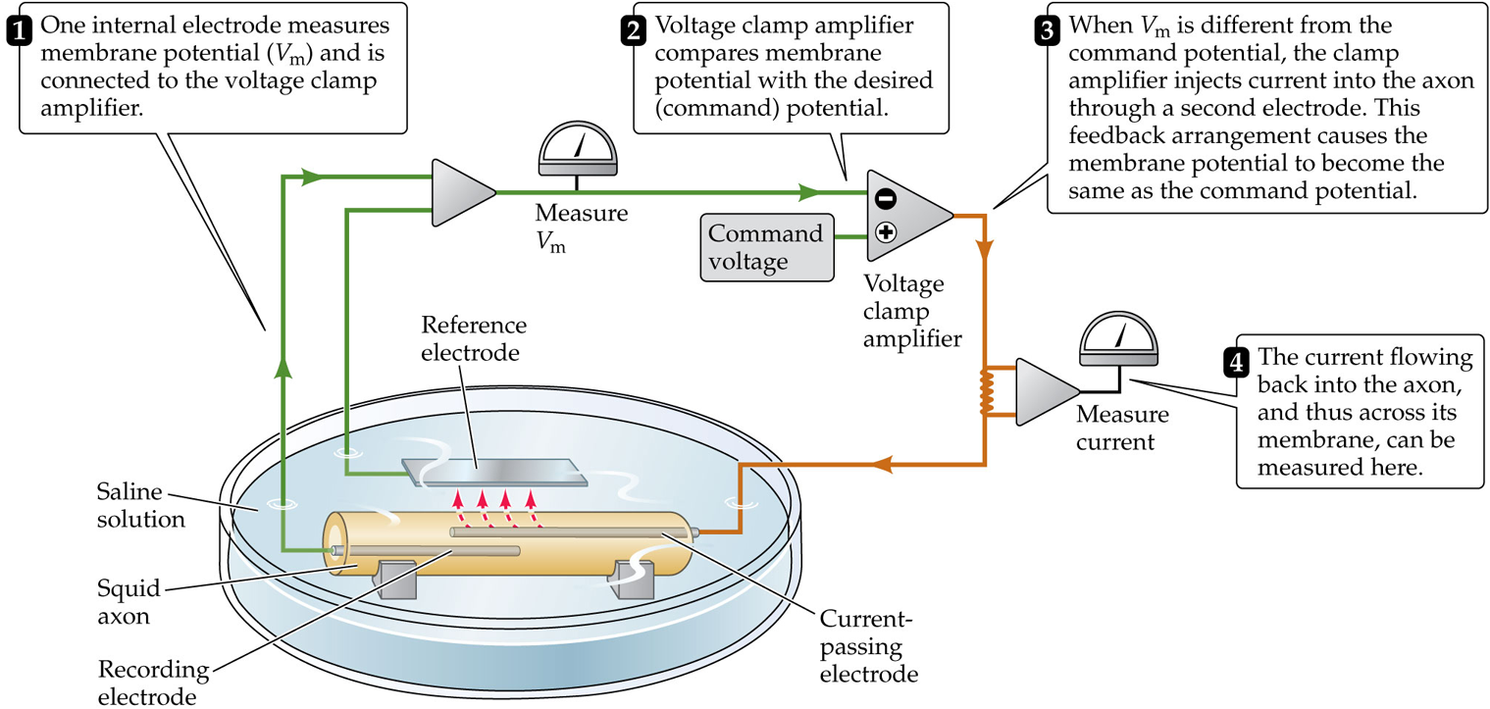
The voltage clamp technique

Slide 8
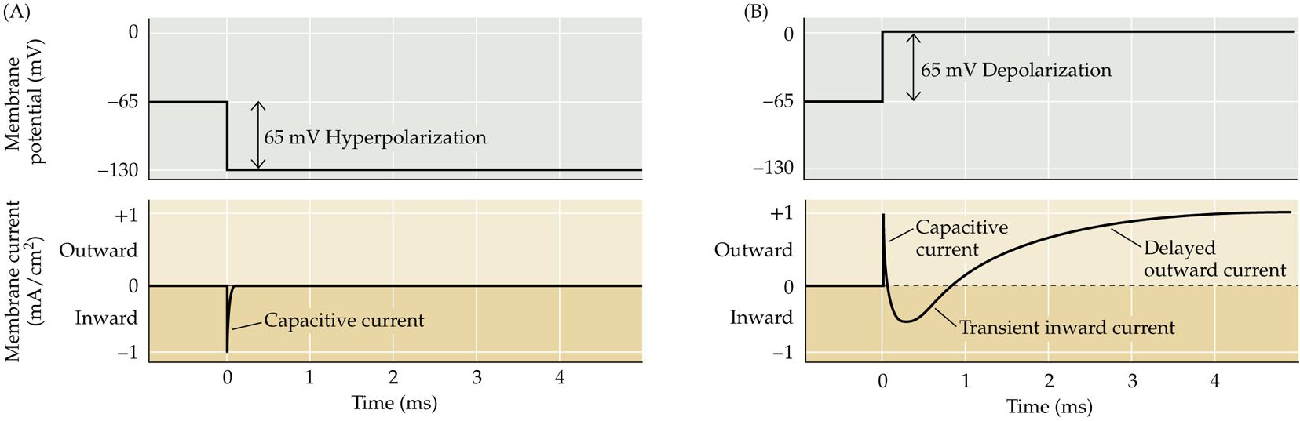
Depolarization elicits 2 ionic currents
Hyperpolarization
depolarization

Slide 9
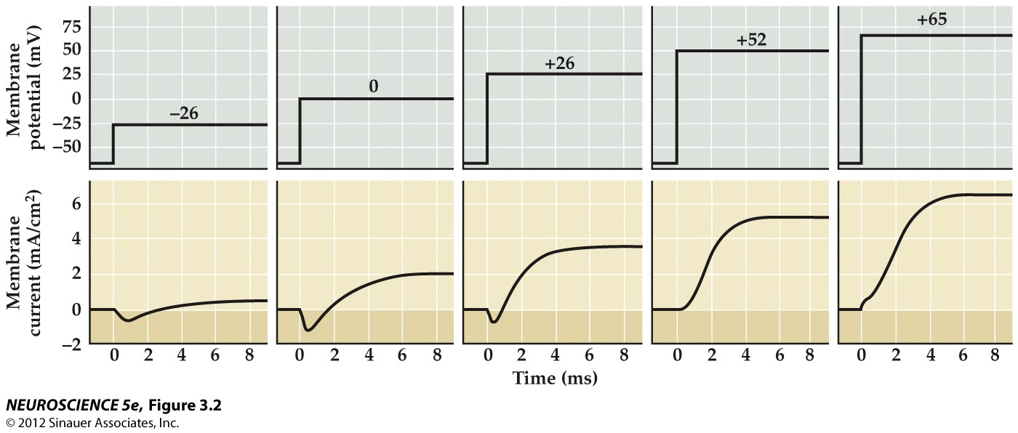
The Early Inward and Late Outward Currents
  Inward
  initially gets larger, then decreases with further depolarization
  with enough depolarization, the early current becomes outward
Early
Late
  Outward
  increases monotonically with depolarization
Late
Early

Slide 10
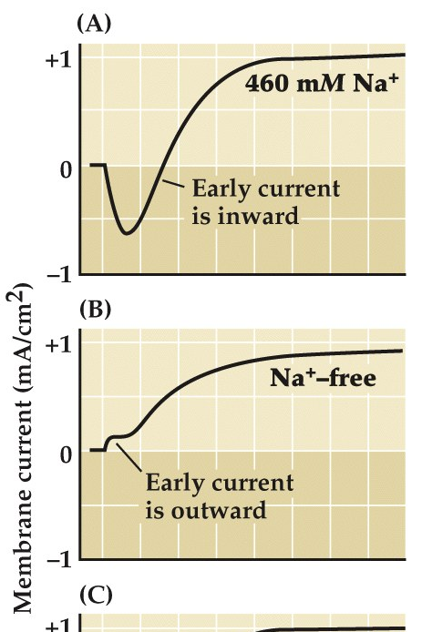
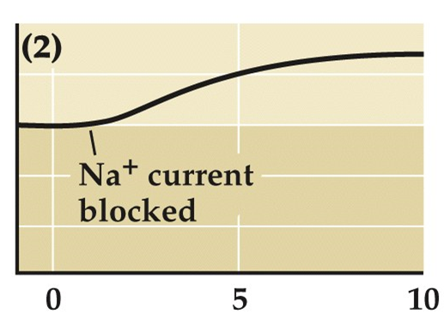
Sodium Conductance Drives the Early Inward current
In normal saline, inward current is followed by outward current.
In sodium-free water, the inward current disappears, but the outward current persists.
  Small early outward current, why?
The chemical TTX blocks voltage gated Na⁺ channels and consequently the early inward current.

Slide 11
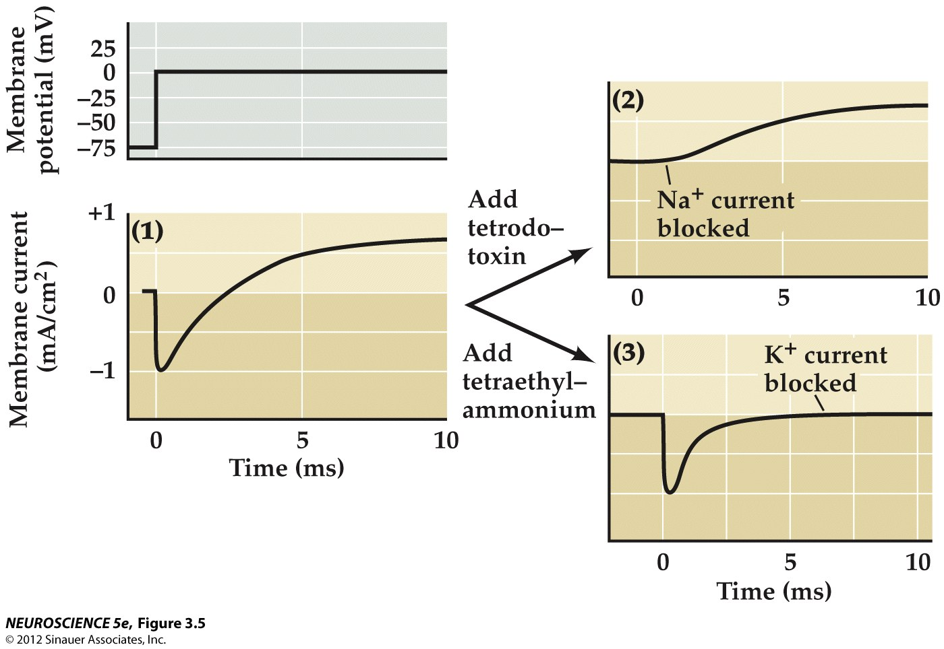
Potassium Conductance Drives the Late outward current
Tetraethyl-ammonium (TEA) selectively blocks voltage-gated K⁺ channels and consequently the late outward current.

Slide 12
Two ionic currents Summary
 | Early Inward Current | Late outward current
Charge Carrier | Sodium | Potassium
In pure water | absent | present
Response to TTX | absent | present
Response to TEA | present | absent

Slide 13
Depolarization of the Membrane Opens ion channels which allows ions to move across the membrane
Δ V_{m}
depolarize
Δ P_{m} (g_{m})
open channels
Δ I_{m}
ions flow

Slide 14
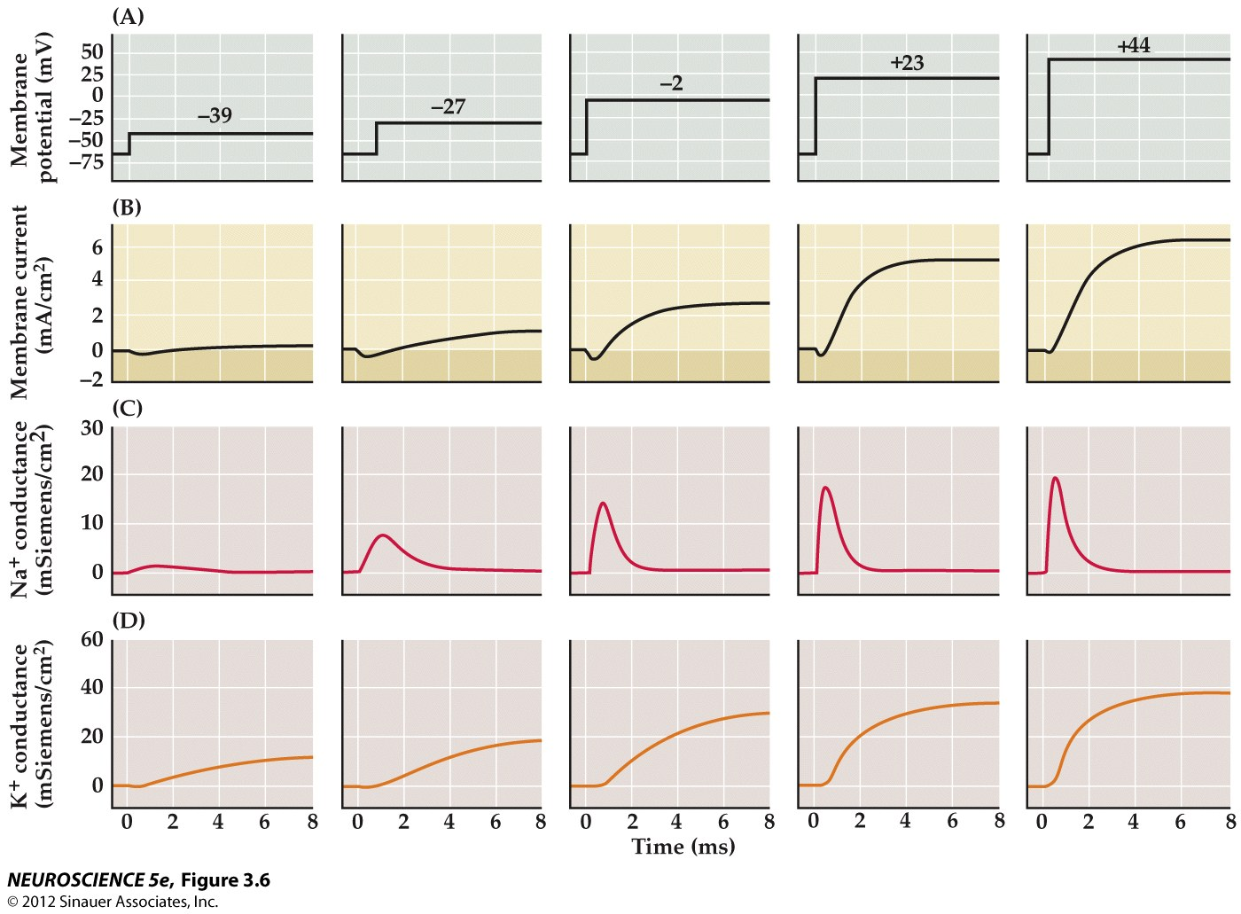
Conductance (g_{m}) is dependent on Membrane potential and time
Membrane must be depolarized.
  Ion channels are voltage gated
Voltage gated sodium channels activate and then inactive quickly.
Voltage gated potassium channels take longer to open, but stay open for a long time.

Slide 15
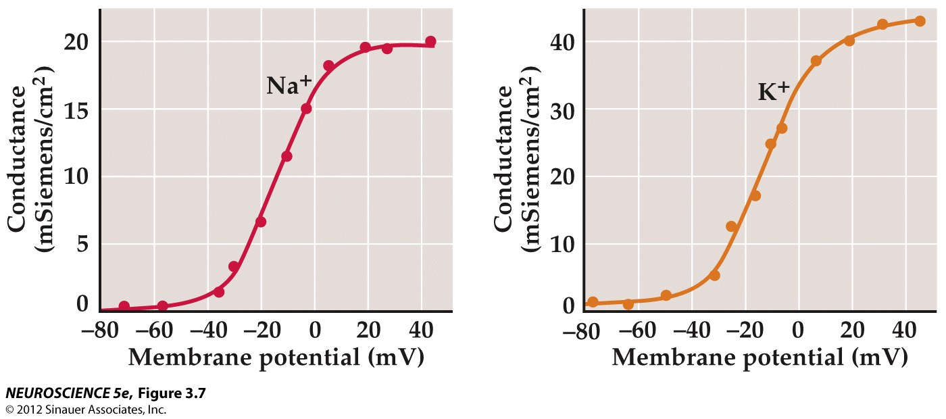
Voltage-dependence means the conductance increases with depolarization

Slide 16
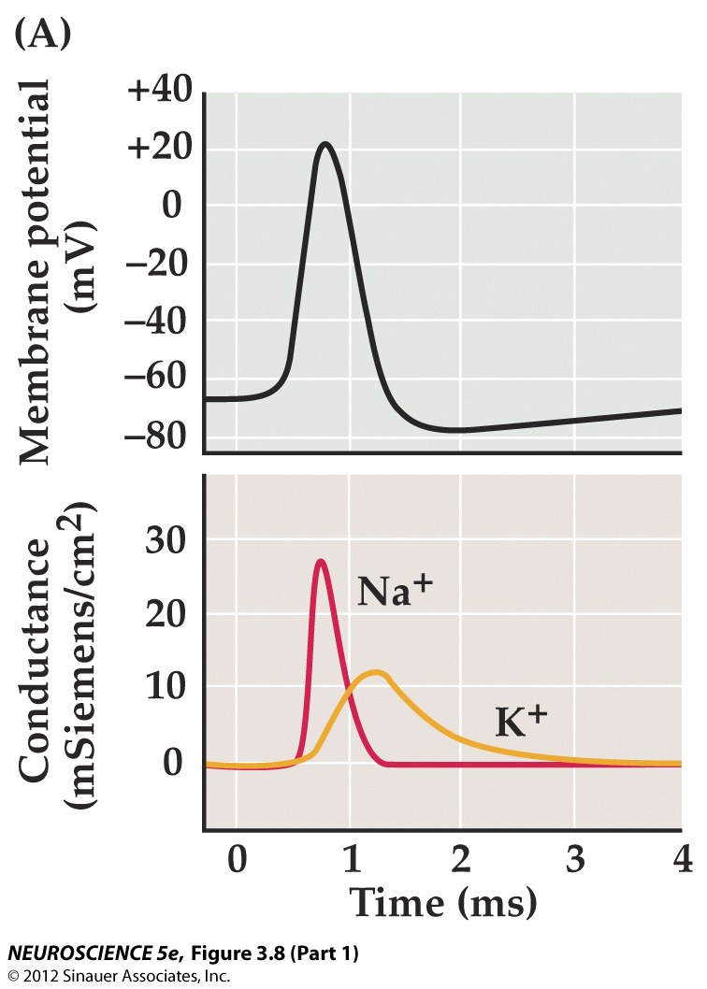

Slide 17
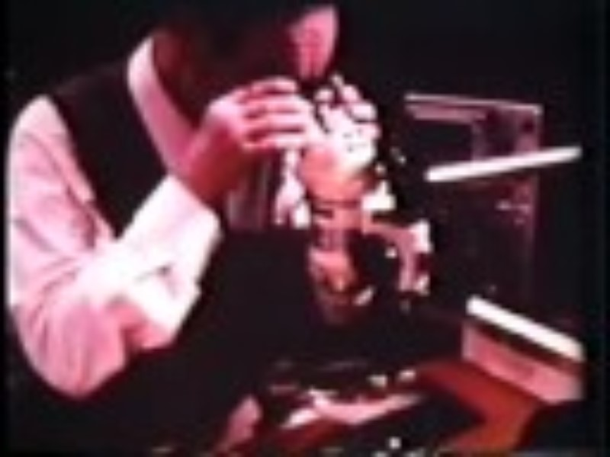
https://www.youtube.com/watch?v=k48jXzFGMc8

